Slide 1

图像压缩标准 Image Compression Standards
授课教师：张小燕
邮箱：xyzhang15@szu.edu.cn
2021年春季课程

Slide 2

知识点回顾
Distortion Measures
– mean square error (MSE,均方差 ) σ ²,
where xn, yn, and N are the input data sequence, reconstructed data sequence, and length of the data sequence respectively.
– signal to noise ratio (SNR,信号噪声比 ), in decibel units (dB),
_{σ}2
SN R = 10 log₁₀
x
_{σ}2
d
σ² is the MSE.
均方
d
σ² is the average square value of the original data sequence
x
– peak signal to noise ratio (PSNR，峰值信噪比),
_{x}2
P SN R = 10 log₁₀
peak
_{σ}2
d

Slide 3



1D DCT and IDCT with 8 numbers
Consider a data sequence with 8 numbers
1D DCT
1D IDCT
The constants C(u) are determined by

Slide 4
Example of Compression Scheme for 1D DCT
Original data X: { 60 36 21 21 17 12 21 38 }
Transform coding T: 1D DCT
Transformed vector Y: 80 20 32 2 16 1 0 0

Slide 5
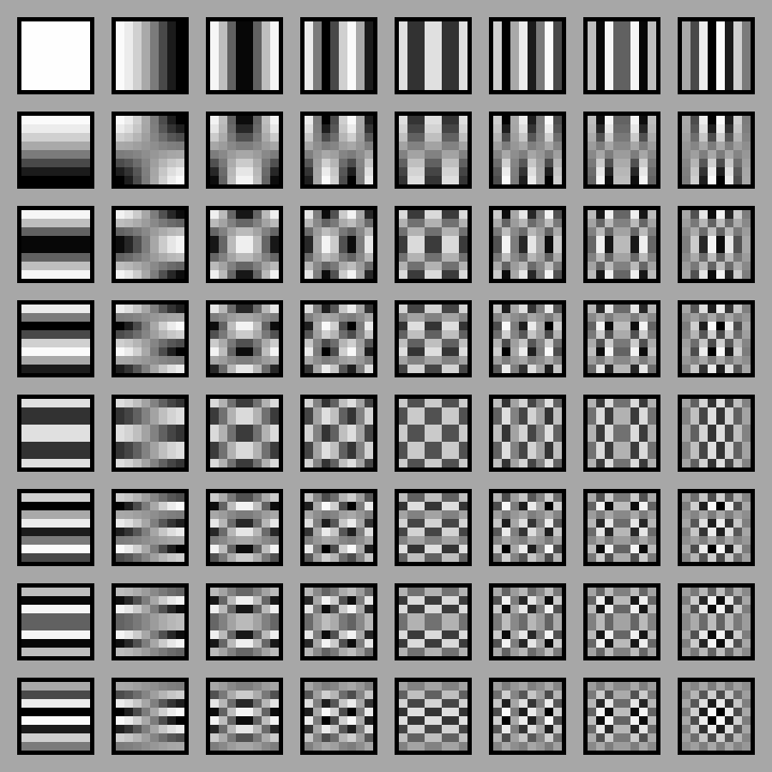
2D DCT and 2D IDCT
Consider an image block with 8 ×8 numbers
2D DCT
2D IDCT
The constants C(u) are determined by

Slide 6
Outline of Lecture 09
Image compression standard JPEG
Block diagram for JPEG encode
Transform RGB color model to YUV or YIQ
DCT coding for image block
Uniform scalar quantization
ZigZag scan for quantized DCT coefficients
DPCM for DC coefficients
RLC for AC coefficients
Entropy coding
JPEG file generation

Slide 7
Image Compression Standard JPEG
JPEG is an image compression standard that was developed by the “Joint Photographic Experts Group”（联合图像专家组）
JPEG was formally accepted as an international standard in 1992
JPEG combines several lossless and lossy compression techniques
Transform coding
Quantization
DPCM （差分脉冲编码调制）
Run-length coding
Entropy coding
Notes:
而且JPEG是一种很灵活的格式，具有调节图像质量的功能，它允许用不同的压缩比例对文件进行压缩，支持多种压缩级别，压缩比率通常在10；1到40；1，压缩比越大，图像品质就越低；相反地，压缩比越小，图像品质就越高。同一幅图像，用JPEG格式存储的文件是其他类型文件的1/10~1/20，通常只有几十KB，质量损失较小，基本无法看出。JPEG格式压缩的主要是高频信息，对色彩的信息保留较好，适合应用于互联网；它可减少图像的传输时间，支持24位真彩色；

Slide 8
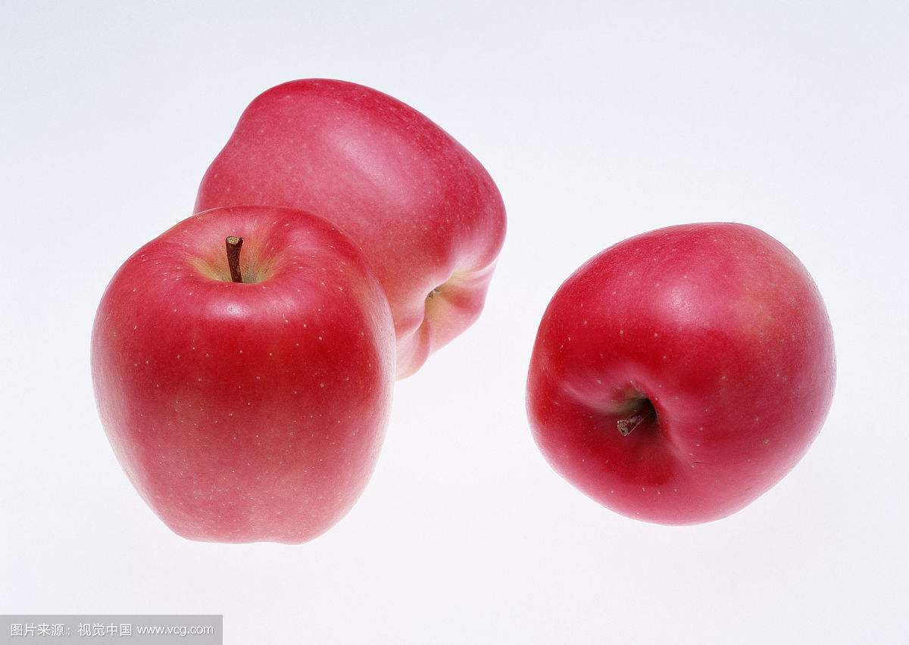
Image Compression Standard JPEG
The effectiveness of the coding method in JPEG relies on 3 major observations:
Observation 1: Useful image contents change relatively slowly across the image, i.e., it is unusual for intensity values to vary widely several times in a small area, for example, within an 8 × 8 image block.
much of the information in an image is repeated, hence “spatial redundancy”.
Use DCT transform

Slide 9
Image Compression Standard JPEG
Observation 2: Psychophysical （心理物理学） experiments suggest that humans are much less likely to notice the loss of very high spatial frequency components than the loss of lower frequency components.
The spatial redundancy can be reduced by largely reducing the high spatial frequency contents.
Observation 3: Visual acuity (敏锐度) is much greater for gray (“black and white”) than for color.
chroma subsampling (4:2:0) is used in JPEG.

Slide 10
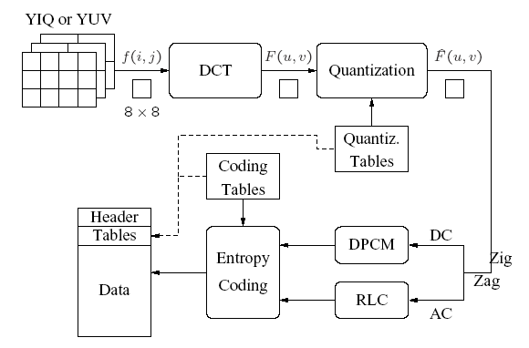
Block Diagram for JPEG Encode

Slide 11
Block Diagram for JPEG Encode
Main Steps in JPEG Image Compression
Transform RGB to YIQ or YUV and subsample color.
DCT on image blocks.
Quantization.
Zig-zag ordering and run-length encoding.
Entropy coding.

Slide 12
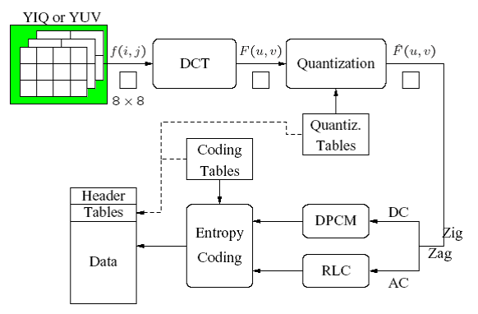
JPEG: Transform RGB Color Model to YUV or YIQ

Slide 13
JPEG: Transform RGB Color Model to YUV or YIQ
Motivation
Partition the image data based on the visual acuity (敏锐度)
Human’s visual acuity is much greater for gray than for color
YUV color model
Y: luminance （亮度）information
U and V: chrominance （色度） information
YIQ color model
Y in YIQ is the same as in YUV
I and Q are a rotated version of U and V
Chroma subsampling (4:2:0) is used in JPEG.
Notes:
敏锐度是人眼分辨物体细节的能力

Slide 14
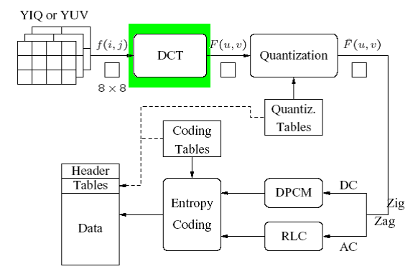
JPEG: DCT Coding for Image Block

Slide 15
Compression Scheme of 2D DCT for Image Data
The DCT formalizes spatial frequency
With a measure of how much the image contents change in correspondence to the number of cycles of a cosine wave per block
Motivation of DCT
Spatial redundancy of the image
Useful image contents change relatively slowly
DCT can concentrate the information within first several components
Humans are not sensitive to the loss of information of high spatial frequency

Slide 16


DCT Coding for Image Block
Partition the image to the blocks of 8 pixels * 8 pixels
2D DCT for each block in encoding part
2D IDCT for each block in decoding part

Slide 17
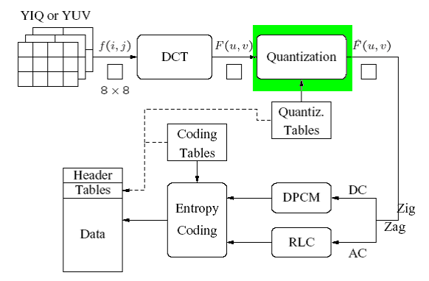
JPEG: Uniform Scalar Quantization

Slide 18
Uniform Scalar Quantization
Motivation
Yield higher compression ratio
Main source for compression in JPEG
Quantize DCT coefficients
F(u,v) represents a DCT coefficients
Q(u,v) is a “quantization table" entry
represents the quantized DCT coefficients

Slide 19
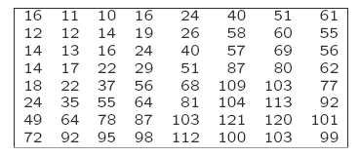
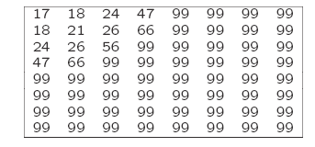
Quantization Table
Use different quantization tables for luminance information and chrominance information
The entries of Q(u,v) tend to have larger values towards the lower right corner
The Luminance Quantization Table
The Chrominance Quantization Table

Slide 20
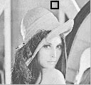
Quantization and Reconstruction
An 8 × 8 block from the Y image of ‘Lena’
200 202 189 188 189 175 175 175 | 515 | 65 | -12 | 4 | 1 | 2 | -8 | 5
200 203 198 188 189 182 178 175 | -16 | 3 | 2 | 0 | 0 | -11 | -2 | 3
203 200 200 195 200 187 185 175 | -12 | 6 | 11 | -1 | 3 | 0 | 1 | -2
200 200 200 200 197 187 187 187 | -8 | 3 | -4 | 2 | -2 | -3 | -5 | -2
200 205 200 200 195 188 187 175 | 0 | -2 | 7 | -5 | 4 | 0 | -1 | -4
200 200 200 200 200 190 187 175 | 0 | -3 | -1 | 0 | 4 | 1 | -1 | 0
205 200 199 200 191 187 187 175 | 3 | -2 | -3 | 3 | 3 | -1 | -1 | 3
210 200 200 200 188 185 187 186 | -2 | 5 | -2 | 4 | -2 | 2 | -3 | 0
f (i, j)
F (u, v)
JPEG compression for a smooth image block.

Slide 21
JPEG compression for a smooth image block.

Slide 22
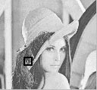
Another 8 × 8 block from the Y image of ‘Lena’
70 70 100 70 87 87 150 187 |  | -80 -40 89 -73 44 32 53 -3
85 100 96 79 87 154 87 113 |  | -135 -59 -26 6 14 -3 -13 -28
100 85 116 79 70 87 86 196 |  | 47 -76 66 -3 -108 -78 33 59
136 69 87 200 79 71 117 96 |  | -2 10 -18 0 33 11 -21 1
161 70 87 200 103 71 96 113 |  | -1 -9 -22 8 32 65 -36 -1
161 123 147 133 113 113 85 161 |  | 5 -20 28 -46 3 24 -30 24
146 147 175 100 103 103 163 187 |  | 6 -20 | 37 -28 | 12 -35 33 | 17
156 146 189 | 70 113 161 163 197 | -5 -23 | 33 -30 | 17 -5 -4 | 20
f (i, j)
F (u, v)
JPEG compression for a textured image block.

Slide 23
JPEG compression for a textured image block.

Slide 24
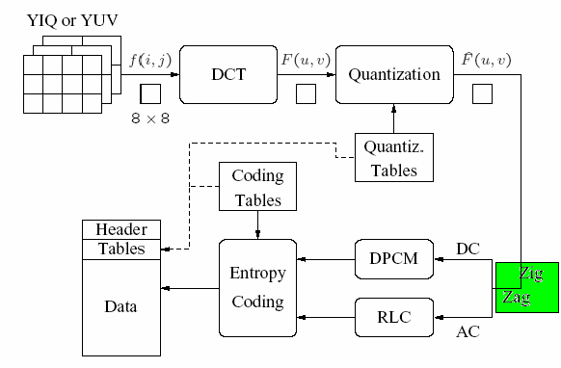
JPEG: ZigZag Scan

Slide 25
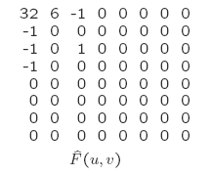
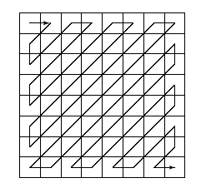
Zig-Zag Scan for Quantized DCT Coefficients
Zig-Zag scan
Zigzag scan result:
(32, 6,-1,-1,0 –1,0,0,0,-1,0,0,1,0,0… … 0)
To make it most likely to hit a long run of zeros: a zig-zag scan is used to turn the 8 × 8 matrix $\hat{F}$(u, v) into a 64-vector.

Slide 26
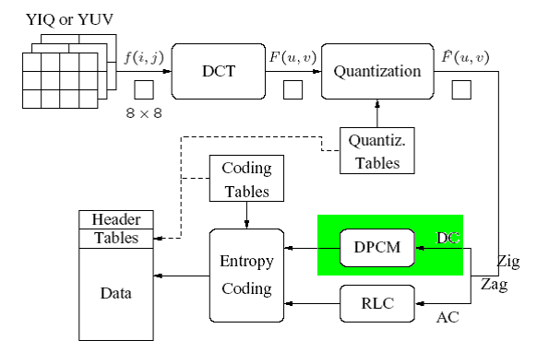
JPEG: DPCM for DC Coefficients

Slide 27
DPCM for DC Coefficients
Quantized DCT coefficients
Direct current (DC) coefficient ~ F(0,0)
Alternate current (AC) coefficient ~ other F(u,v)
DPCM is the coding method for DC coefficients
Differential Pulse Code Modulation （差分脉冲编码调制）
Example of encoding DC coefficients
assuming d_{i} = DC_{i+1} − DC_{i}, and d₀ = DC₀.
DC coefficients for the first 5 image blocks: 150,155, 149, 152, 144
Coding result: 150, 5, -6, 3, -8
Reference reading
中文版 P106 (P172 英文版)

Slide 28
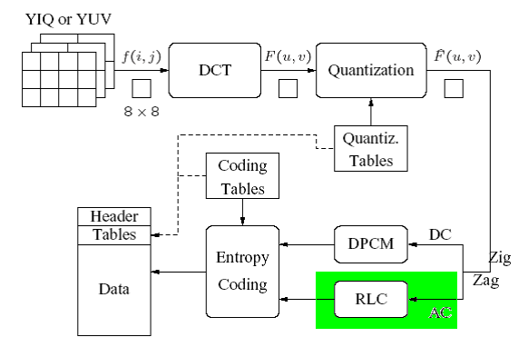
JPEG: RLC for AC Coefficients

Slide 29

Run-length Coding (RLC, 游长编码) on AC coefficients
RLC aims to turn the $\hat{F}$(u, v) values into sets
{#-zeros-to- skip , next non-zero value}.
Zigzag scan result
(32, 6,-1,-1,0 –1,0,0,0,-1,0,0,1,0,0… … 0)
Modified Run-Length coding result
(0,6)(0,-1)(0,-1)(1,-1)(3,-1)(2,1)(0,0)

Slide 30
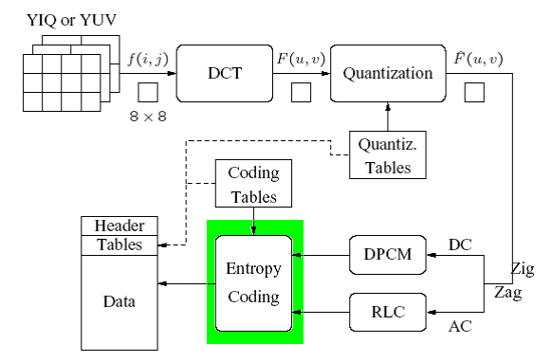
JPEG: Entropy Coding

Slide 31
Entropy Coding
The DC and AC coefficients finally undergo an entropy coding step to gain a possible further compression
Each DPCM coded DC coefficient is represented by (SIZE, AMPLITUDE)
DC coefficients for the first 5 image blocks: 150,155, 149, 152, 144
Coding result: 150, 5, -6, 3, -8
In (SIZE, AMPLITUDE) format：
（8，10010110）（3，101）（3，001）（2，11）（4，0111）
负数表示为正数的反码，以0开头的都为负数
SIZE is Huffman coded

Slide 32
Entropy Coding
Each RLC coded AC coefficient (RUNLENGTH, VALUE) is represented by (RUNLENGTH, SIZE, AMPLITUDE)
Zigzag scan result
(32, 6,-1,-1,0 –1,0,0,0,-1,0,0,1,0,0… … 0)
Modified Run-Length coding result
(0,6)(0,-1)(0,-1)(1,-1)(3,-1)(2,1)(0,0)
In (RUNLENGTH, SIZE, AMPLITUDE) format
(0,3,110)(0,1,0)(0,1,0)(1,1,0)(3,1,0)(2,1,1)(0,0,0)
RUNLENGTH, SIZE各用4位表示，整合成一个字节，用哈夫曼编码
AMPLITUDE use actual values

Slide 33
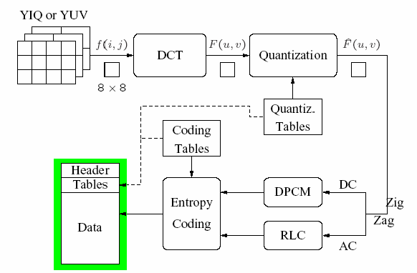
JPEG File Generation

Slide 34
JPEG File Generation
A Glance at the JPEG Bitstream
Start_of_image | Frame | End_of_image
Tables, etc. | Header | Scan | . . . | Scan
Tables, etc. | Header | Segment | Restart | Segment | Restart | . . .
Block | Block | Block | . . .
JPEG bitstream.

Slide 35
扩展
阅读第9章 9.2 The JPEG2000 Standard，介绍JPEG2000相对于标准JPEG的改进。

